Slide 1

Customer Churn Prediction – Telecom Industry
Data Mining Project | Fall 2024
Notes:
“Good [morning/afternoon], everyone. Today, we will be presenting our analysis of customer churn in the telecommunications industry. Our team—comprising Lasyasri, MaryLisa, Shiny, Tony, and myself, Jaymin—has focused on understanding the factors that contribute to customer churn and developing actionable insights that telecom companies can use to retain their customers. Let’s begin by diving into the business problem.”

Slide 2
Business Problem Statement
Objective:
The telecommunications industry faces significant losses due to customer churn.
Our goal is to predict churn and identify which customers are at risk.
Business Impact:
Churn leads to lost revenue and high acquisition costs for new customers.
By predicting churn, companies can take proactive actions to reduce churn.

Slide 3




Dataset Overview
Dataset Source:
Kaggle - Telco Customer Churn Dataset
https://www.kaggle.com/datasets/mazenalattar/telco-customer-churn
Target Variable – 'Churn'
Yes = 1 (Churned)
No = 0 (Not Churned)
7043 Rows
21 Columns
Features
Total Revenue: $456,116.60
From Churned : $139,130.85
From Non-Churned: $316,985.75
Key Features:
Demographics: Gender, Senior Citizen, Partner, Dependents
Account Information: Contract, Payment Method, Paperless Billing
Service Usage: Monthly Charges, Total Charges, Tenure
Services Subscribed: Internet, Phone, Streaming TV/Movies
Target Variable: Churn (1 = Churned, 0 = Retained)

Slide 4
Data Directory
Classification Labels
Churn | Whether the customer churned or not (Yes or No)
Customer Service Provided
PhoneService | Whether the customer has a phone service (Yes or No)
MultipleLines | Whether the customer has multiple lines (Yes, No, No phone service)
InternetService | Customer's internet service provider (DSL, Fiber optic, No)
OnlineSecurity | Whether the customer has online security (Yes, No, No internet service)
OnlineBackup | Whether the customer has online backup (Yes, No, No internet service)
DeviceProtection | Whether the customer has device protection (Yes, No, No internet service)
TechSupport | Whether the customer has tech support (Yes, No, No internet service)
StreamingTV | Whether the customer has streaming TV (Yes, No, No internet service)
StreamingMovies | Whether the customer has streaming movies (Yes, No, No internet service)
Customer Account Info
Tenure | How long the customer has stayed with the company (Months)
Contract | The type of contract (Month-to-month, One Year, Two Year)
PaperlessBilling | Whether the customer uses paperless billing (Yes or No)
PaymentMethod | The customer's payment method (Electronic check, Mailed check, etc.)
MonthlyCharges | Amount charged monthly ($)
TotalCharges | Total amount charged ($)
Demographics
Gender | Whether the customer is male or female
SeniorCitizen | Whether the customer is a senior citizen (Yes or No)
Partner | Whether the customer has a partner (Yes or No)
Dependents | Whether the customer has dependents (Yes or No)

Slide 5
Data Pre - processing & EDA
Data Pre-processing:
Handled missing values (filled TotalCharges NaNs with the column mean).
Dropped irrelevant columns (e.g., customerID).
One-hot encoded categorical variables (e.g., gender, contract, payment method).
Converted Churn into a binary target variable (1 = Churned, 0 = Retained).
EDA Highlights:
Correlation Analysis: Showed that tenure has a negative correlation with churn.
Churn Distribution: 26.5% of customers churned.
Churn by Contract: Customers with month-to-month contracts are more likely to churn.
Churn by Payment Method: Electronic check users have higher churn rates.

Slide 6
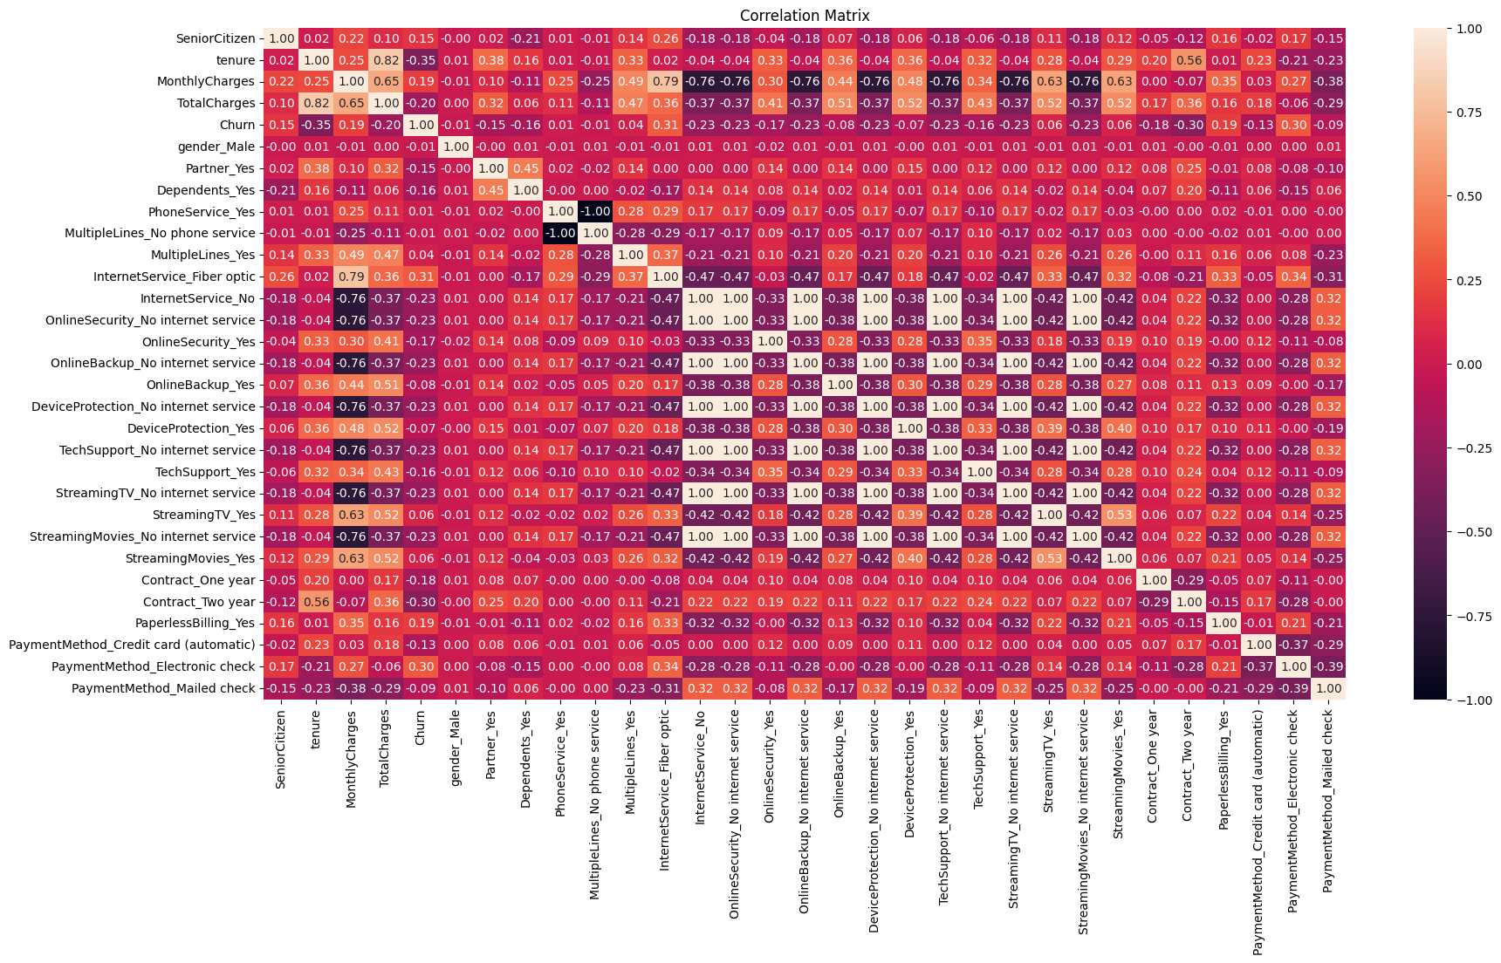
Understanding Feature Relationships
Churn vs. Tenure:
Found that customers with shorter tenures are more likely to churn.
Monthly Charges vs. Churn:
Higher monthly charges are correlated with higher churn rates, indicating price sensitivity.
Correlation Heatmap:
Presented a heatmap to show correlations between key features like TotalCharges, tenure, and Churn.
Service Type vs. Churn:
Explored how specific services (e.g., fiber optic internet, phone services) affect customer retention.
*Visuals and detailed EDA are available in the accompanying code notebook.

Slide 7
Model Evaluation
Model | Precision | Recall | F1-Score | Accuracy | ROC AUC
Logistic Regression | 0.627049 | 0.579545 | 0.602362 | 0.808803 | 0.858854
Optimized KNN | 0.597723 | 0.596591 | 0.597156 | 0.798864 | 0.848249
Decision Tree | 0.667665 | 0.422348 | 0.517401 | 0.803124 | 0.815523
Random Forest | 0.681034 | 0.448864 | 0.541096 | 0.809749 | 0.858554
Boosted Tree | 0.231003 | 0.143939 | 0.177363 | 0.666351 | 0.471776
Naive Bayes | 0.42538 | 0.901515 | 0.578021 | 0.671084 | 0.834675
ANN | 0.556478 | 0.63447 | 0.59292 | 0.7823 | 0.821886

Slide 8
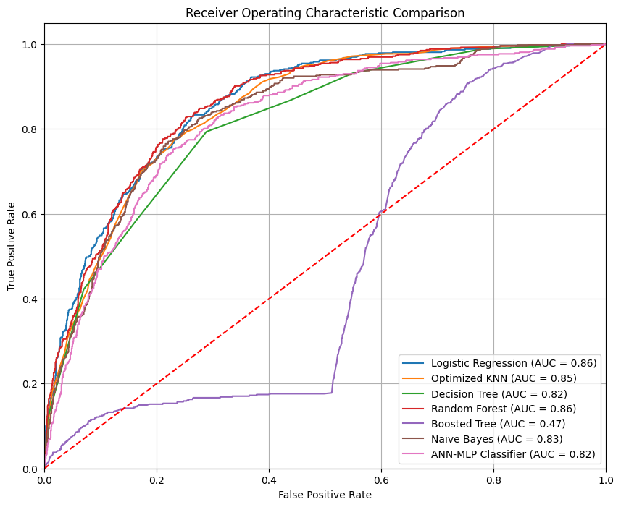
Model Selection
Logistic Regression = High ROC AUC

Slide 9
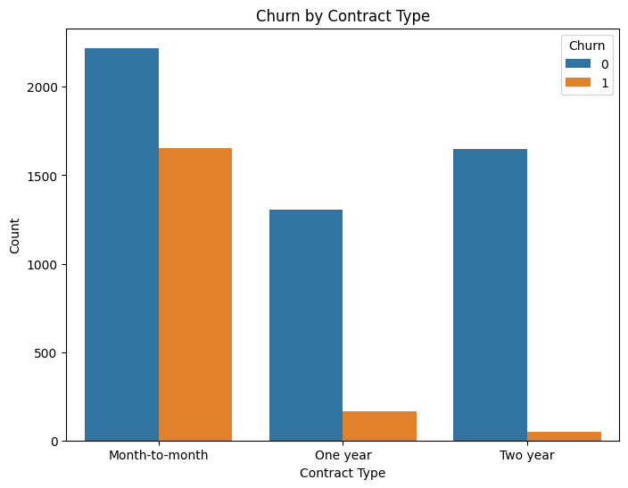
Churn by Contract Type
Insight:
Customers with month-to-month contracts are more likely to churn compared to those with one or two-year contracts. This indicates that customers on short-term contracts are less committed and more prone to leaving.
Actionable Recommendation:
Target Customers on Month-to-Month Contracts with Incentives:
Offer discounts or promotions to encourage customers on month-to-month contracts to switch to longer-term plans (e.g., 1-year or 2-year contracts).
Provide loyalty programs or exclusive benefits to incentivize longer commitments and reduce churn risk.
Customer Account Information

Slide 10
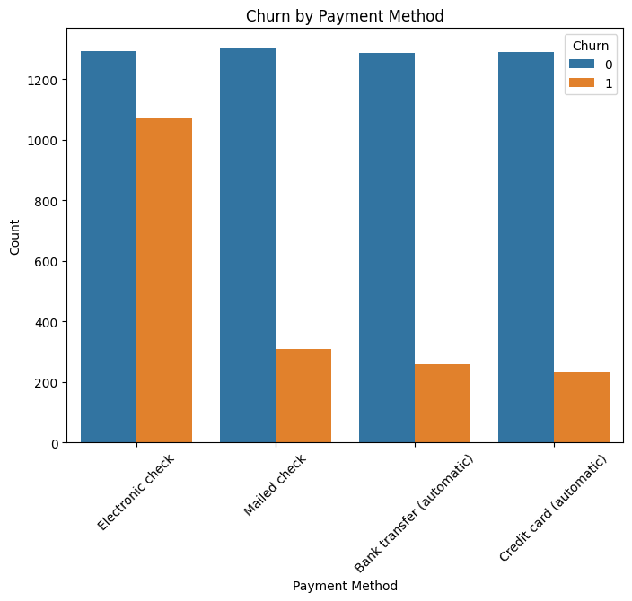
Churn by Payment Method
Insight:
Customers paying via electronic check have the highest churn rate compared to other payment methods. This suggests that electronic check payments may be less convenient or associated with higher dissatisfaction.
Actionable Recommendation:
Promote More Reliable Payment Methods:
Offer incentives for customers to switch from electronic checks to more convenient payment methods such as credit cards or automatic bank transfers.
Consider providing discounts or loyalty rewards for customers using automatic payment methods, reducing the likelihood of churn.
Customer Account Information

Slide 11
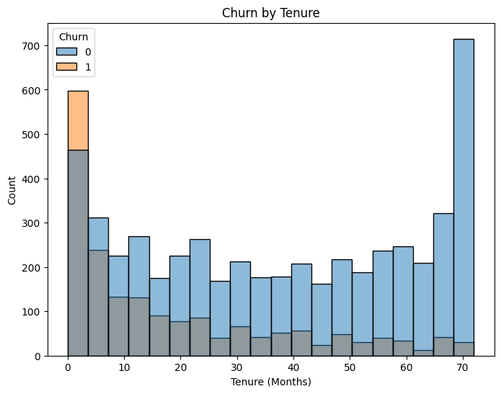
Churn by Tenure
Insight:
Customers with shorter tenure (less than one year) are more likely to churn, especially during the first few months of their subscription. On the other hand, customers with longer tenure (beyond two years) show significantly lower churn rates.
Actionable Recommendation:
Implement Early Retention Strategies:
Focus on new customers in the first year of their subscription, offering welcome campaigns, special offers, or customer support initiatives to enhance satisfaction and reduce churn.
Consider offering long-term incentives for customers who reach the one-year mark to encourage further retention.
Service Usage Information

Slide 12
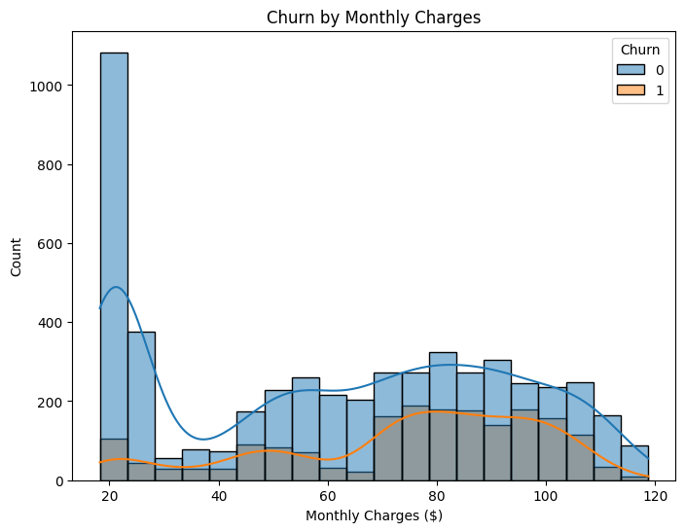
Churn by Monthly Charges
Insight:
Customers with higher monthly charges are more likely to churn. This suggests that customers who pay more may feel they are not receiving sufficient value for the cost of their subscription, or they may seek more affordable alternatives.
Actionable Recommendation:
Introduce Tiered Pricing or Loyalty Discounts:
Offer loyalty discounts or rewards for customers with higher monthly charges to incentivize them to stay and feel more valued.
Consider introducing tiered pricing models to offer more affordable options for high-paying customers, preventing them from leaving for cheaper alternatives.
Service Usage Information

Slide 13
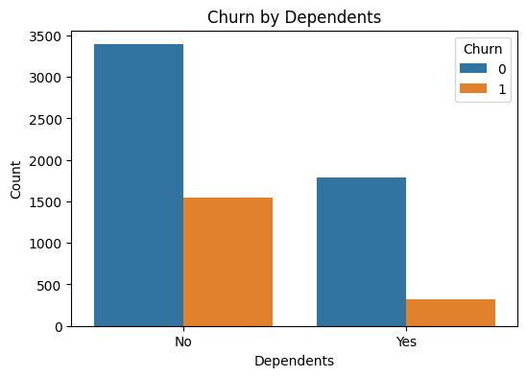
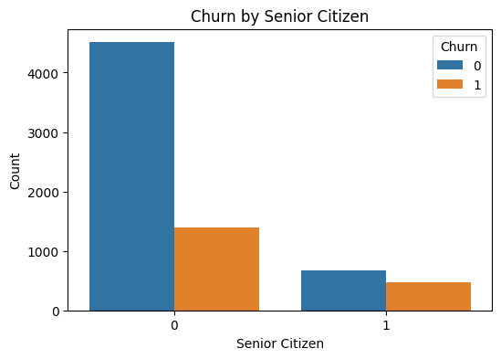
Churn by Demographics
Insight:
Customers without dependents and younger customers (non-senior citizens) have a higher churn rate. This suggests that these demographic groups might be less tied to the service and more likely to switch to competitors.
Gender does not show significant differences in churn rates.
Actionable Recommendation:
Tailor Retention Efforts to At-Risk Demographics:
Create targeted marketing campaigns aimed at younger customers or those without dependents, emphasizing the value and convenience of the service.
Offer family plans or group discounts to attract customers with dependents, incentivizing them to stay with the service.

Slide 14
Department Wise Action Plan
Department | Key Actions
Marketing | Target month-to-month customers with loyalty programs. Launch campaigns promoting service value for young customers and those without dependents.
Customer Retention & Success | Focus on early retention strategies (first-year customers). Provide personalized onboarding and regular customer support check-ins.
Sales | Offer special discounts to convert month-to-month customers to long-term contracts. Provide incentives for automatic payments.
Finance | Introduce tiered pricing models and loyalty discounts for high-paying customers. Offer discounts for switching to automatic payment methods.
Product Development | Gather feedback to improve services, especially for high-churn groups. Develop family plans and targeted features for customers with dependents.

Slide 15
Project Summary & Business Impact
📌 Project Summary
• Analyzed 7,000+ customer records from a telecom dataset
• Applied 7 machine learning models for churn prediction
• Logistic Regression and Random Forest yielded ROC AUC > 0.85
• Key drivers of churn: tenure, monthly charges, contract type, payment method
• Recommendations: Loyalty plans, early-stage offers, auto-pay incentives
•
💡 Business Impact
• Enables targeted retention campaigns
• Reduces acquisition costs by retaining existing users
• Informs pricing and contract strategies

